Slide 1
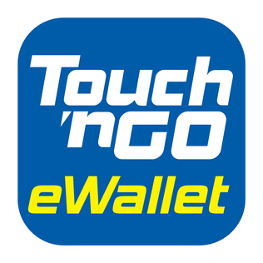

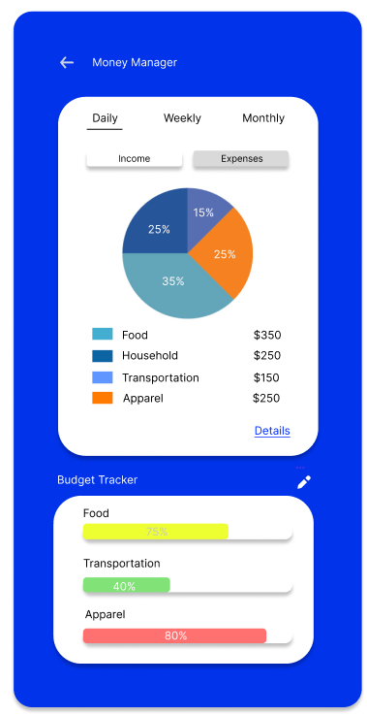
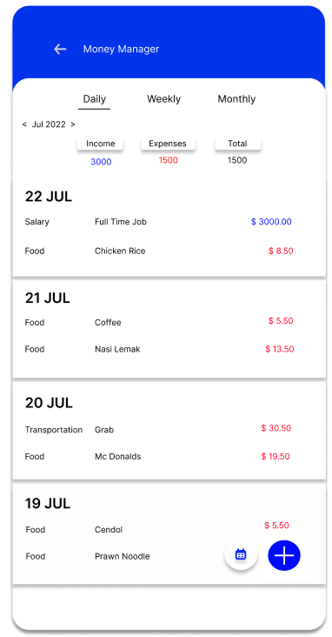
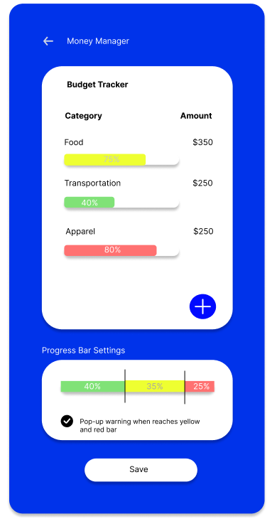
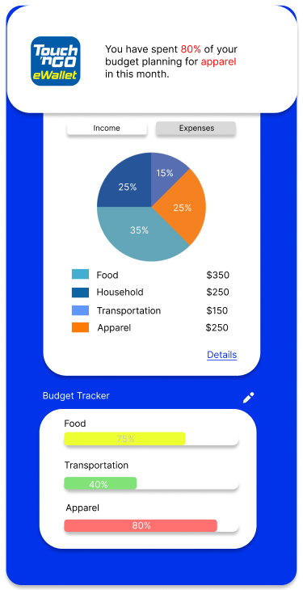
tNG Money manager
View your income/expenses and track your budget
Set your budget for each category and pop-up warning metrics
1
3
Manually add non-T&G eWallet transactions
Pop-up warning triggered
2
4

Slide 2
Problem statement
In 2021, a financial survey done by RinggitPlus revealed that more than 50% respondents only saved less than RM1000 per month, and majority of them indicated that they would not be able to survive beyond 3 months of being unemployed. Another review paper concluded a generally low financial literacy among Malaysians regardless of ages and backgrounds (Aziz & Kassim, 2020). This is further supported by a survey by the Credit Counselling and Debt Management Agency (AKPK) which found that 1 out of 3 Malaysians rated themselves as having a low level of confidence about financial management. To put oneself at a better financial position, one can begin simple steps by making budget and tracking expenses at your fingertips with the help of digital devices.

Slide 3
market/consumer needs
An e-wallet that records all the transactions/spendings (a.k.a inflow & outflow) to give an overview of the transactions at the end of each day/week/month
An e-wallet that reminds the users that they have already overspent by pre-setting a budget for daily/weekly/monthly usage
An e-wallet that provides financial insights into the users’ spendings to better understand and manage their financial habits
A digital budget tracker which is safe to use and ensures user privacy
A digital budget tracker which is affordable to use
A digital budget which is user-friendly, convenient and integrated well in mobile device ecosystem

Slide 4
value proposition
Cash flow visualisation
Gain creators
Good financial habit
Stress-free spending
Investments
Progress bar
Financial data analyses
Financial control
Satisfaction
Plan budget
Automatic data update from TNG transactions
Gains
Data encryption and biometric authentication
Financial insight
Manage spending
Data security and privacy
Financial security
Job-To-Be-Done
Daily/monthly/annual spending tracker
Emergency fund enabler
Products & services
Effortless money tracking
Financial overview
Smart expenses categorisation
Ads-free
Overspending
Savings
Various spending (sub)categories available
Forget to record spending
Poor UI design
Spending report and advice
Achieve financial goals
Pains
Annoying ads
Data syncing and backup
Spending alert and reminder
Simple and intuitive design
Expensive subscription
Manual record
Premium subscription fee goes as low as RM0.99/month
Pain relievers
Unorganised
Limited features

Slide 5
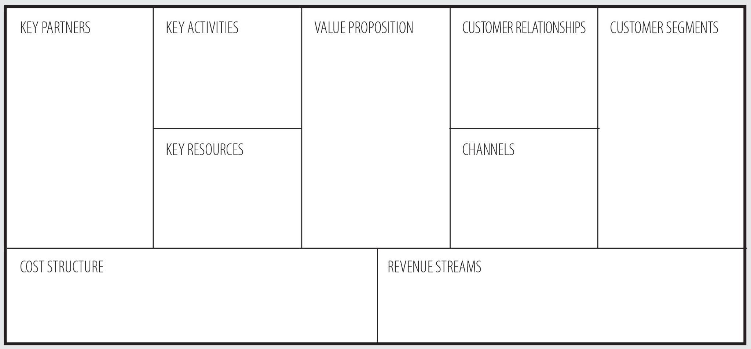
business model
Software developer
Marketing
All-in-one
24/7 customer service
‘Busy Bee’ consumers
Software update and debugging
Easy-to-use
Newsletter
Virtual assistance
Cloud service provider
Shopaholics
Financial management
Convenience
Customer feedback
Cybersecurity provider
Business-minded people
Security and privacy
Merchants
Community
Financially-conscious people
TNG E-Wallet platform
TNG branding
Financial planning
Low cost, high value
T&G e-wallet app/website
Transaction data
Social media
Personal growth
Accessibility
People (engineers, technicians, service)
Search engine
Sales and marketing
Innovation and exploration
System maintenance
Premium subscriptions
Transaction fees
Human resources
Software development

Slide 6
closing REmarks
While there are existing money manager apps in the market, but it requires expensive subscriptions to access unlimited features such as account linking and automatic categorisation. Meanwhile bank account syncing in third party apps impose data safety concerns. With our proposed idea of an affordable budget tracker integrated in TNG e-wallet without the use of of sensitive bank account data, users are able to utilise the multifaceted services of financial budgeting, creating saving goals and planning investments in a fuss-free, secured and all-in-one manner while enjoying other built-in functions of e-wallet.

